Slide 1
SMART VOTING CENTRE
Group Members
Md.Mahfujur Rahman - 011161156
Nazia parvin Urmi - 011161201
Progya Paromita Urmee - 011161157

Slide 2
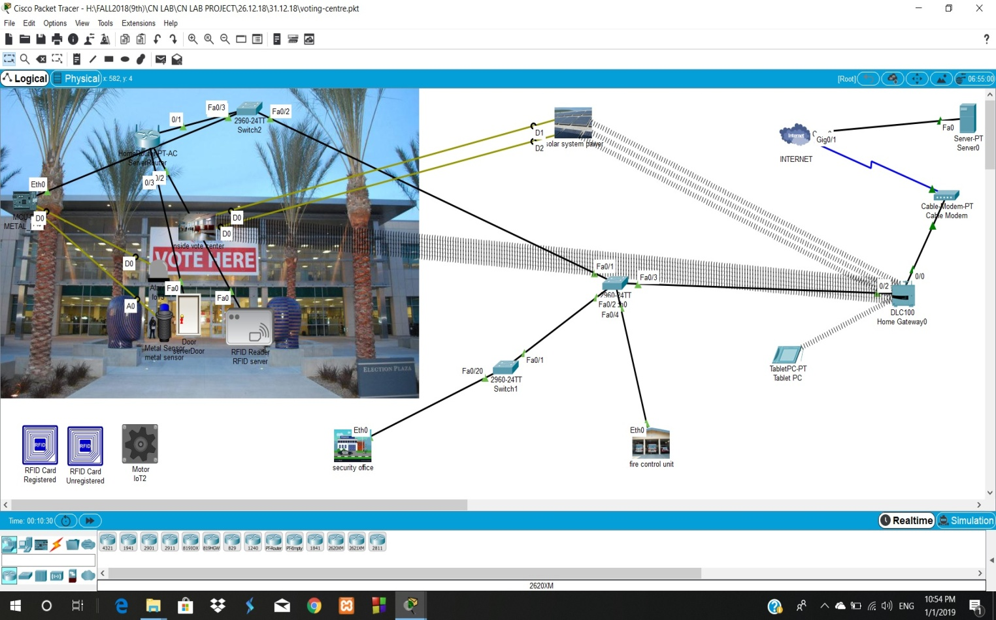
Why we would need this?
We need to secure the voting centre by smart way for the fare election.
We need to monitor everything from the server.
Notes:
As we know Dhaka is the most densely populated city on the planet earth. For this growing number of population several problems emerge. Traffic congestion is one of them.
So hours of time is wasted sitting on the road waiting in the traffic jam
Traffic signal is not distributed properly among highly congested and low congested roads
Detecting vehicles violating signals, which is the major cause of traffic congestion
Be acknowledged of upcoming congestion

Slide 3
Objective
In this project we try to secure our voting center & get monitored by election commission server & then take necessary actions.

Slide 4
Components
Sensors
Motion sensor
Metal sensor
Temperature sensor
Fire detector
IoT Components
Camera
LCD
Alarm
Door
Fan
Light
Actuators
Fire Sprinkler
RFID card reader
RFID card
Motor
Alarm
Heating element
LCD
Others
MCU
Wireless router
Switch
Environment

Slide 5
Project Features
Centralized Server
Smart Security System
Smart Door Parts
Detect metallic things
Solar panel

Slide 6
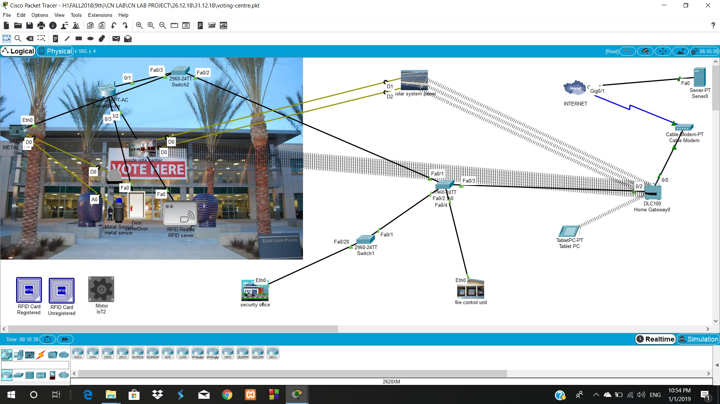
Fig: Simplified diagram

Slide 7
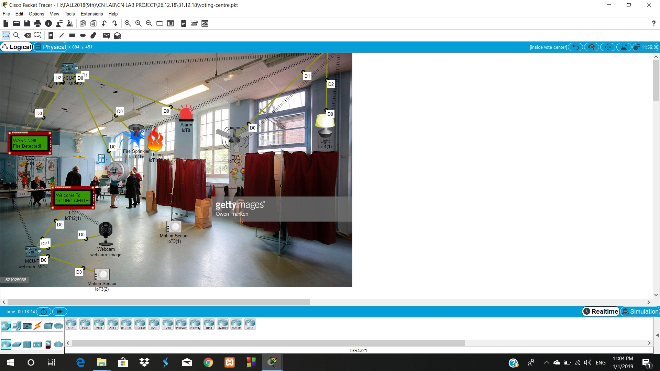
Inside the voting centre

Slide 8
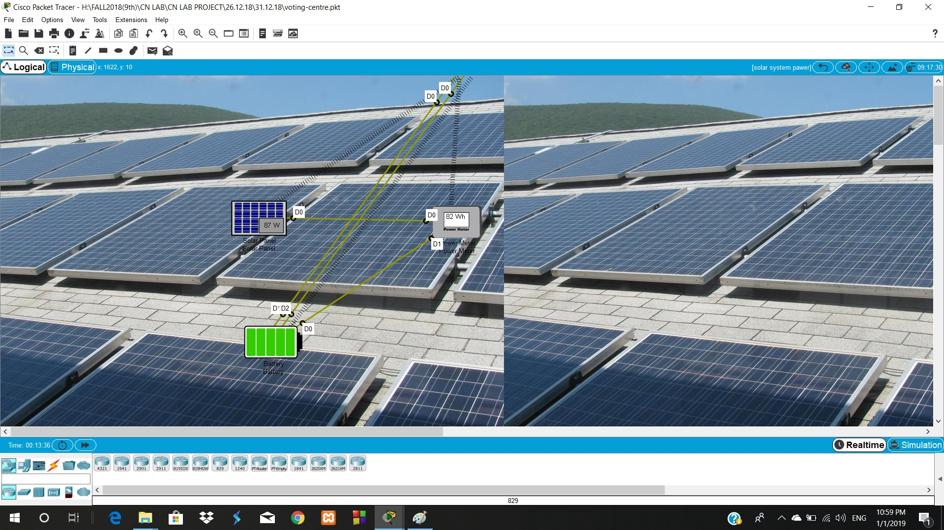
Solar Panel

Slide 9
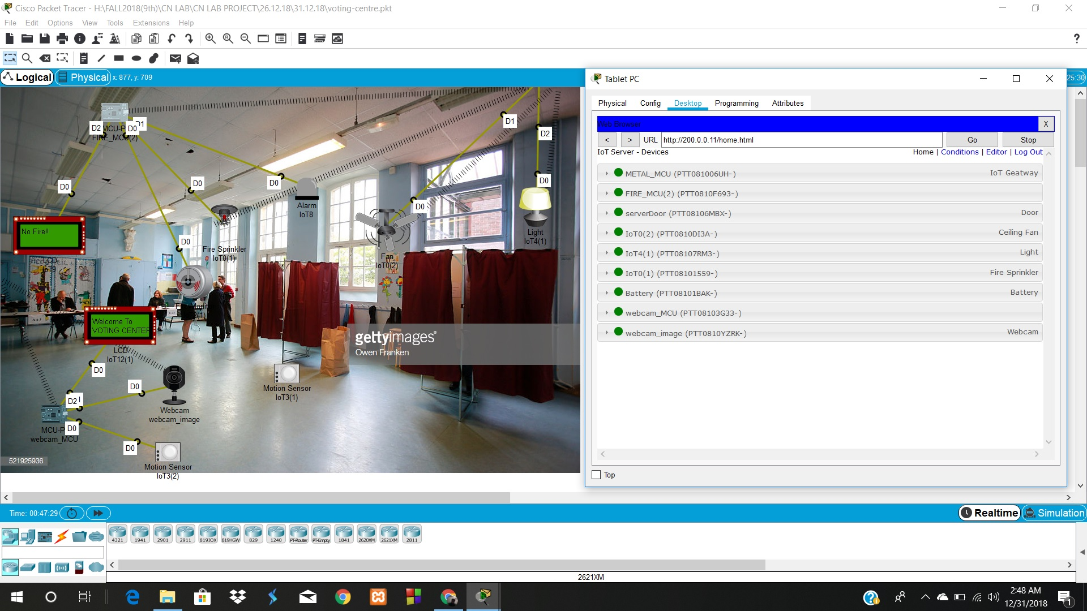
Monitored By Registration Server

Slide 10
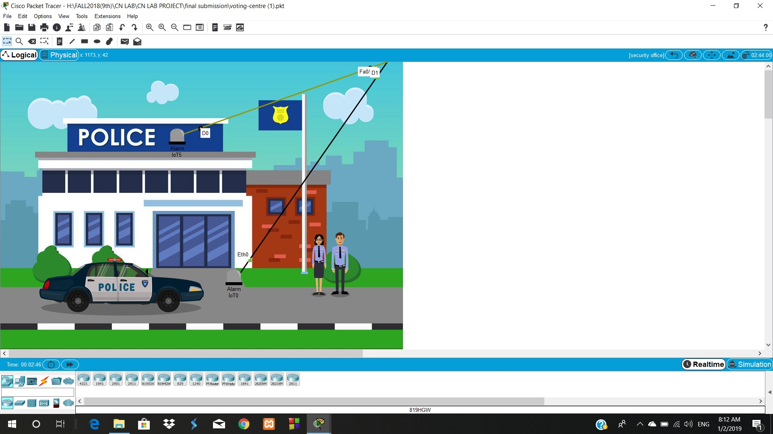
Security Office

Slide 11
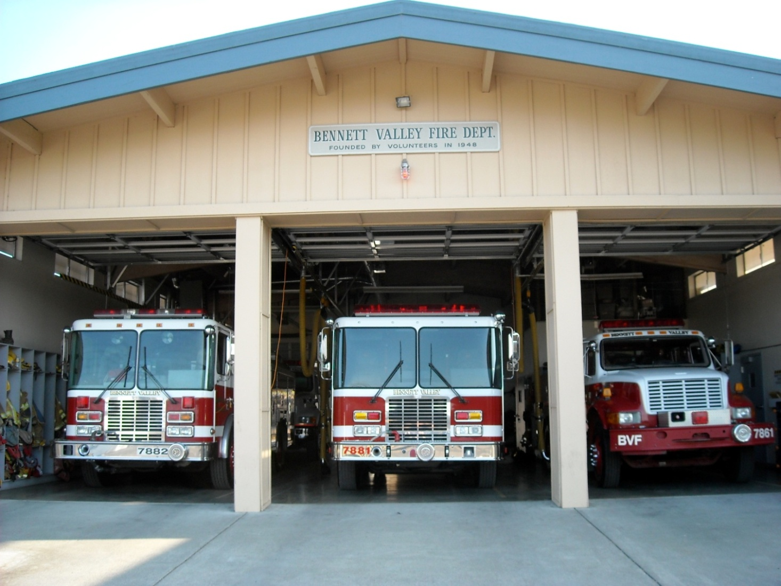
Fire Brigade

Slide 12
Project implementation
Setting up Registration Server
Connect a wireless router and complete routing configuration
Connect the necessary sensors with the MCU
Necessary coding implementation
Connect the MCU and other IoT components with the router
Provide necessary condition on the registration server for having IoT devices interconnectivity

Slide 13
Thank You…..

